Slide 1
COMP460/560-17B
Intermediate Result Presentation
Group 4
Zoren Cayanan, Regi Medina, June Chong

Slide 2
Recap
Our group has agreed to create a Weapon Based World Builder
Breakdown
Step 1: Create the VR Environment
Step 2: Get models to represent the weapons (building tools)
Step 3: Place objects into the environment
Step 4: Interact with placed objects using the weapons (e.g. Move, Rotate, Scale)
Step 5: Build the interaction system
Step 6: Refinement of details & Evaluation

Slide 3
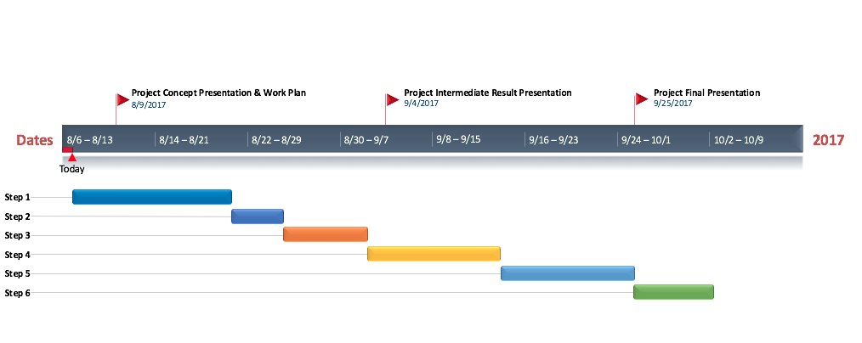
Recap
Calendar / Timeline

Slide 4
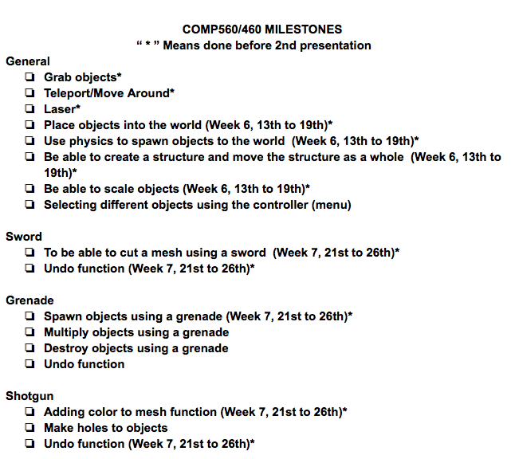

Adjustments
Sample of our checklist

Slide 5
Adjustments
Based on recommendations, we are now focusing on interaction.
Originally, we wanted to include detailed objects.
Challenges
Each function is time consuming
Difficulties in implementation
Learning curve
Errors in code
We created a more detailed plan based on the original breakdown.
Notes:
Unkown errors that are difficult to diagnose
As a result, we struggled to compete the tasks we set for ourselves

Slide 6
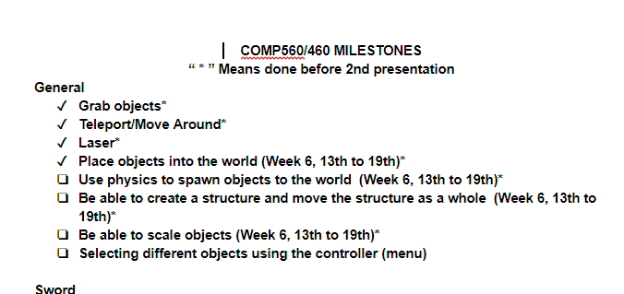
Accomplishments

Slide 7
Demonstration
Show Video

Slide 8
To continue this project..
Show image of checklist again

Slide 9
Questions?

Slide 10
Topics
Accomplishments
Demonstration
Changes in plans
Tasks
Previous Presentation
Adjustments
Accomplishments
Demonstration, To continue this project, Questions

